Slide 1
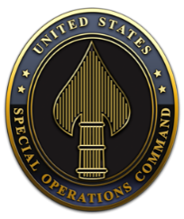
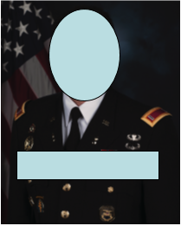
Biography
Hometown
Commissioning Source / Enlistment Point and Initial training site
Career Field
MAJOR SNUFFY SMITH – US ARMY, 25A
Major Snuffy Smith was born in Fairfax, Virginia. He received his Bachelor of Arts Degree in Business Administration from Furman University, Greenville, South Carolina, in May 2003. He received his commission as a Second Lieutenant of Field Artillery from the Reserve Officers Training Corps and was assigned to Fort Sill, OK, in June 2003.
CIVILIAN EDUCATION
Bachelor of Arts, Criminal Justice, Eastern Washington University, 2001
Master of Business Administration, Human Resources, Trident University, 2013
PROFESSIONAL MILITARY EDUCATION
Air Defense Officer Basic Course, 2002
Adjutant General Captain Career Course, 2007
Army Command and General Staff College, 2013
Joint and Combined Warfighter School, 2019
ASSIGNMENTS (Current and 4 Previous)
1. April 2016 – Current, Director, J4, White House Communications Agency, Joint Base Anacostia-Bolling, DC
2. July 2014 – April 2016, Brigade XO, 1 BCT, 101st DIV (ABN), Fort Campbell, KY
3. January 2010 – July 2014, Chief of Training, United States Military Academy, West Point, NY
4. May 2009 – January 2010, Student, Field Artillery Captain’s Career Course, Fort Sill, OK
5. October 2008 – May 2009, Company Commander, Special Troops Battalion, 3D Sustainment Brigade, Fort Stewart, GA
PERSONAL AWARDS AND HONORS
Bronze Star Medal with one oak leaf cluster
Meritorious Service Medal
Army Commendation Medal with two oak leaf clusters
Military Outstanding Volunteer Service medal
FAMILY:
Spouse – Susan
Daughter – Lisa (11 years old)
Son – John (5 years old)

