Slide 1
SOCOM NIPR / SIPR Account Instructions
Please fill out the forms completely and make sure to follow the instructions provided in this PowerPoint very carefully. Failure to do so will delay and/or prevent the account from being created in a timely manner.
A few other things that hold users up on accounts is not sending a current DoD Cyber Awareness Challenge certificate and not having access in JPAS. The DoD Cyber Awareness Challenge certificate must be current and up to date within the last year. The SOCKOR security officer needs to sign off on the 2875 and if you are not visible or verified in JPAS, he/she cannot sign off on the document. This usually happens when someone has not in-processed with their S2.
ALL DOCUMENTS MUST BE FILLED OUT DIGITALLY.
When saving your documents, please follow this method: Last Name, First Name MI Rank Unit (ex. Doe, John D MAJ 1SFG)
REQUIRED DOCUMENTS:
Completed IMT - Doe, John D MAJ 1SFG IMT
Completed SOCKOR AUP - Doe, John D MAJ 1SFG SOCOM AUP
DoD Cyber Awareness Challenge Certificate - Doe, John D MAJ 1SFG IA CERT (05 APR 2017) … date of expiration
Info Text File - Doe, John D MAJ 1SFG INFO
Please direct any questions to SOCKOR/SOJ6Helpdesk@socom.mil

Slide 2
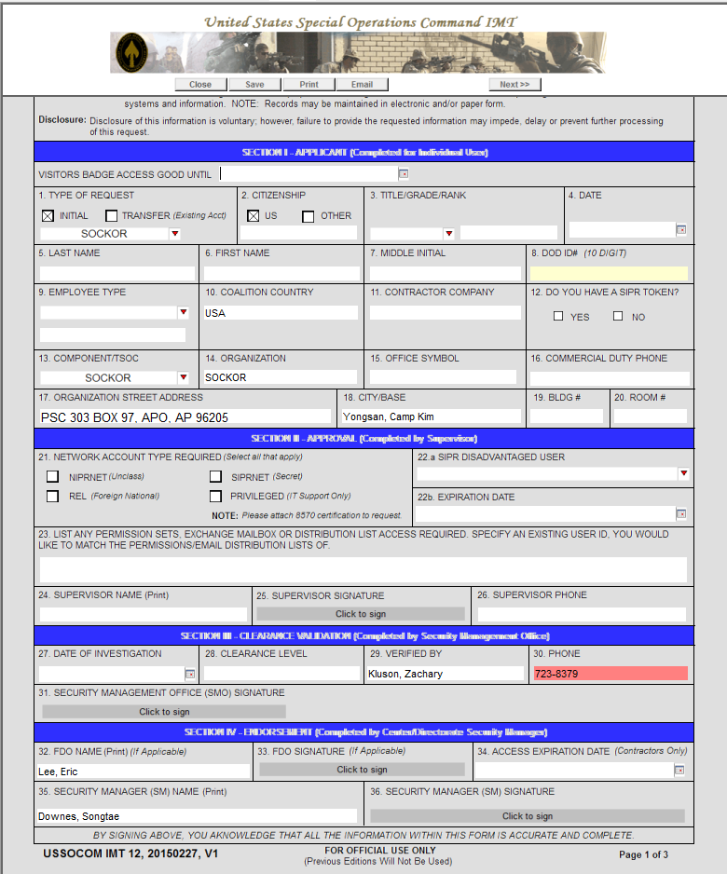
Input Information
Input Information
Input Information
Input Information
Input Information
Input Information
Input Information
Input Information
Input Information
Input Information
Input Information
Input Information
USSOCOM IMT 12
Check box/boxes
Input Date
Supervisor Information
Supervisor Digi Sign
Supervisor Information
Leave Blank
DOB
Leave Blank
Leave Blank
Leave Blank
Leave Blank
Leave Blank
Leave Blank
Leave Blank

Slide 3
USSOCOM IMT 12 cont.
User Digi Sign
Input Date

Slide 4
SOCKOR AUP
Input Information
Input Information
Input Information
Select
User Digi Sign
Input Information

Slide 5
DoD Cyber Awareness
Challenge Certificate
The JKO equivalent is also acceptable (not shown).

Slide 6
Input Information
Info Document

