Slide 1
Medical Considerations: Hurricane Ian
Approved
  TRICARE: PRIMARY CARE MANAGER (PCM) WAIVER
    Issued by TRICARE Region East Humana Military and applicable to all beneficiaries in the area
    Allows members to access off base network Urgent Care facilities WITHOUT a referral
    Members still required to follow-up with PCM (when conditions permit)
    Retain ALL receipts and documentation
      Will assist with any claims that need to be filed
      Will enable information to be entered into MHS Genesis
  TRICARE: EMERGENCY PRESCRIPTION REFILL AUTHORIZED BY DHA
    Allows members to receive prescription refills WITHOUT need for new script from your PCM
    Filled by another MTF or any off-base network pharmacy authorized for all patients
  All routine patient care at 6th MDG and Sabal Park Clinics from 27-30 September 2022 will be rescheduled

Slide 2
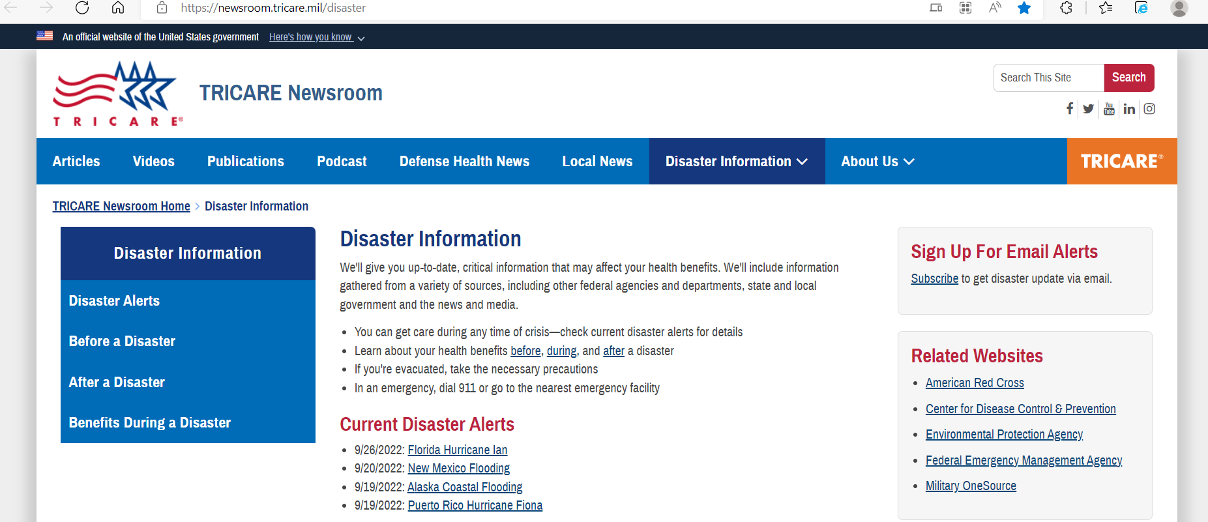
Beneficiaries can check status updates at www.tricare.mil/disaster

Slide 3
Medical Considerations During Disasters
Post-Disaster phase – Safety Tips
  Stay away from loose or dangling power lines
  Avoid drinking or using tap water until you are sure it has not been contaminated. Check with County Florida Dept of Health for any "boil water" notices
  Don't eat food from your refrigerator if the temperature of the food has risen above 40° F for two hours or longer; bacteria grow exponentially causing foodborne illnesses
  Stay out of any building that is surrounded with water
  Wear protective clothing and a mask when cleaning up
  Be on the lookout for loose tree branches, parts of buildings or other types of debris when you are outside. Use caution.
  Drive only when absolutely necessary and avoid flooded roads and washed-out bridges

